Slide 1
More UI Elements
Jianjun.Chen@xjtlu.edu.cn

Slide 2
Contents
More UI initialisation methods
Events
Main Thread (UI Thread)
Control UI through non-UI threads
Notifications
Toast
Notification channels

Slide 3
More UI Initialisation Methods
LayoutParams, LayoutInflater

Slide 4
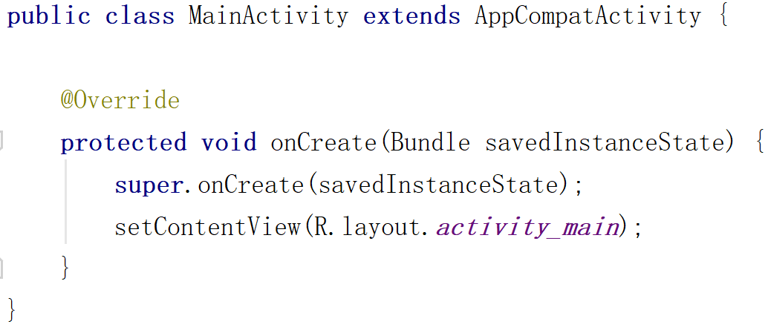
Create Layouts Using Java Code
It is convenient to create layouts using layout XML directly.
Sometimes one might want to manually define UI using Java code. For example:
Show additional UI when a user clicks a button.
Adjust UI layout based on some image downloaded from the Internet.
In the UI designer, you can set properties like width and height. How to do so in Java?

Slide 5
The LayoutParams Class
The Java counterpart uses LayoutParams.
Layout parameters are nested classes (defined inside ViewGroup subclasses) that extends ViewGroup.LayoutParams.
Base class:
android.view.ViewGroup.LayoutParams
Subclasses:
FrameLayout.LayoutParams,
GridLayout.LayoutParams,
GridLayoutManager.LayoutParams,
LinearLayout.LayoutParams,
LinearLayoutCompat.LayoutParams,
…

Slide 6
Create Layouts Using Java Code
protected void onCreate(Bundle savedInstanceState) { super.onCreate(savedInstanceState); LinearLayout layout = new LinearLayout(this); layout.setOrientation(LinearLayout.VERTICAL);
TextView tv1 = new TextView(this); tv1.setText("Label 1");
tv1.setTextSize(45); TextView tv2 = new TextView(this); tv2.setText("Label 2");
tv2.setTextSize(45);
layout.addView(tv1, new LinearLayout.LayoutParams(
LinearLayout.LayoutParams.MATCH_PARENT,
LinearLayout.LayoutParams.WRAP_CONTENT)); layout.addView(tv2, new LinearLayout.LayoutParams(
LinearLayout.LayoutParams.MATCH_PARENT, LinearLayout.LayoutParams.WRAP_CONTENT)); this.setContentView(layout); }
Don’t forget

Slide 7
Create Layouts Using Java Code
Different layouts have their own unique settings.
LinearLayout.LayoutParams has a field called weight
GridLayout.LayoutParams instead have column and row.
Thus, child Views should use objects of LayoutParams of its parent.
Android will detect and correct when you use a wrong one. But some settings might not be applied properly.
LinearLayout layout = new LinearLayout(this);
layout.addView(tv1, new LinearLayout.LayoutParams(
LinearLayout.LayoutParams.MATCH_PARENT,
LinearLayout.LayoutParams.WRAP_CONTENT));

Slide 8
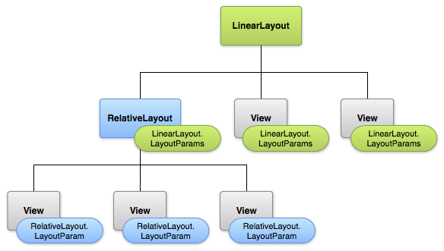
Layout Hierarchy Overview
child Views should use objects of LayoutParams of its parent.

Slide 9
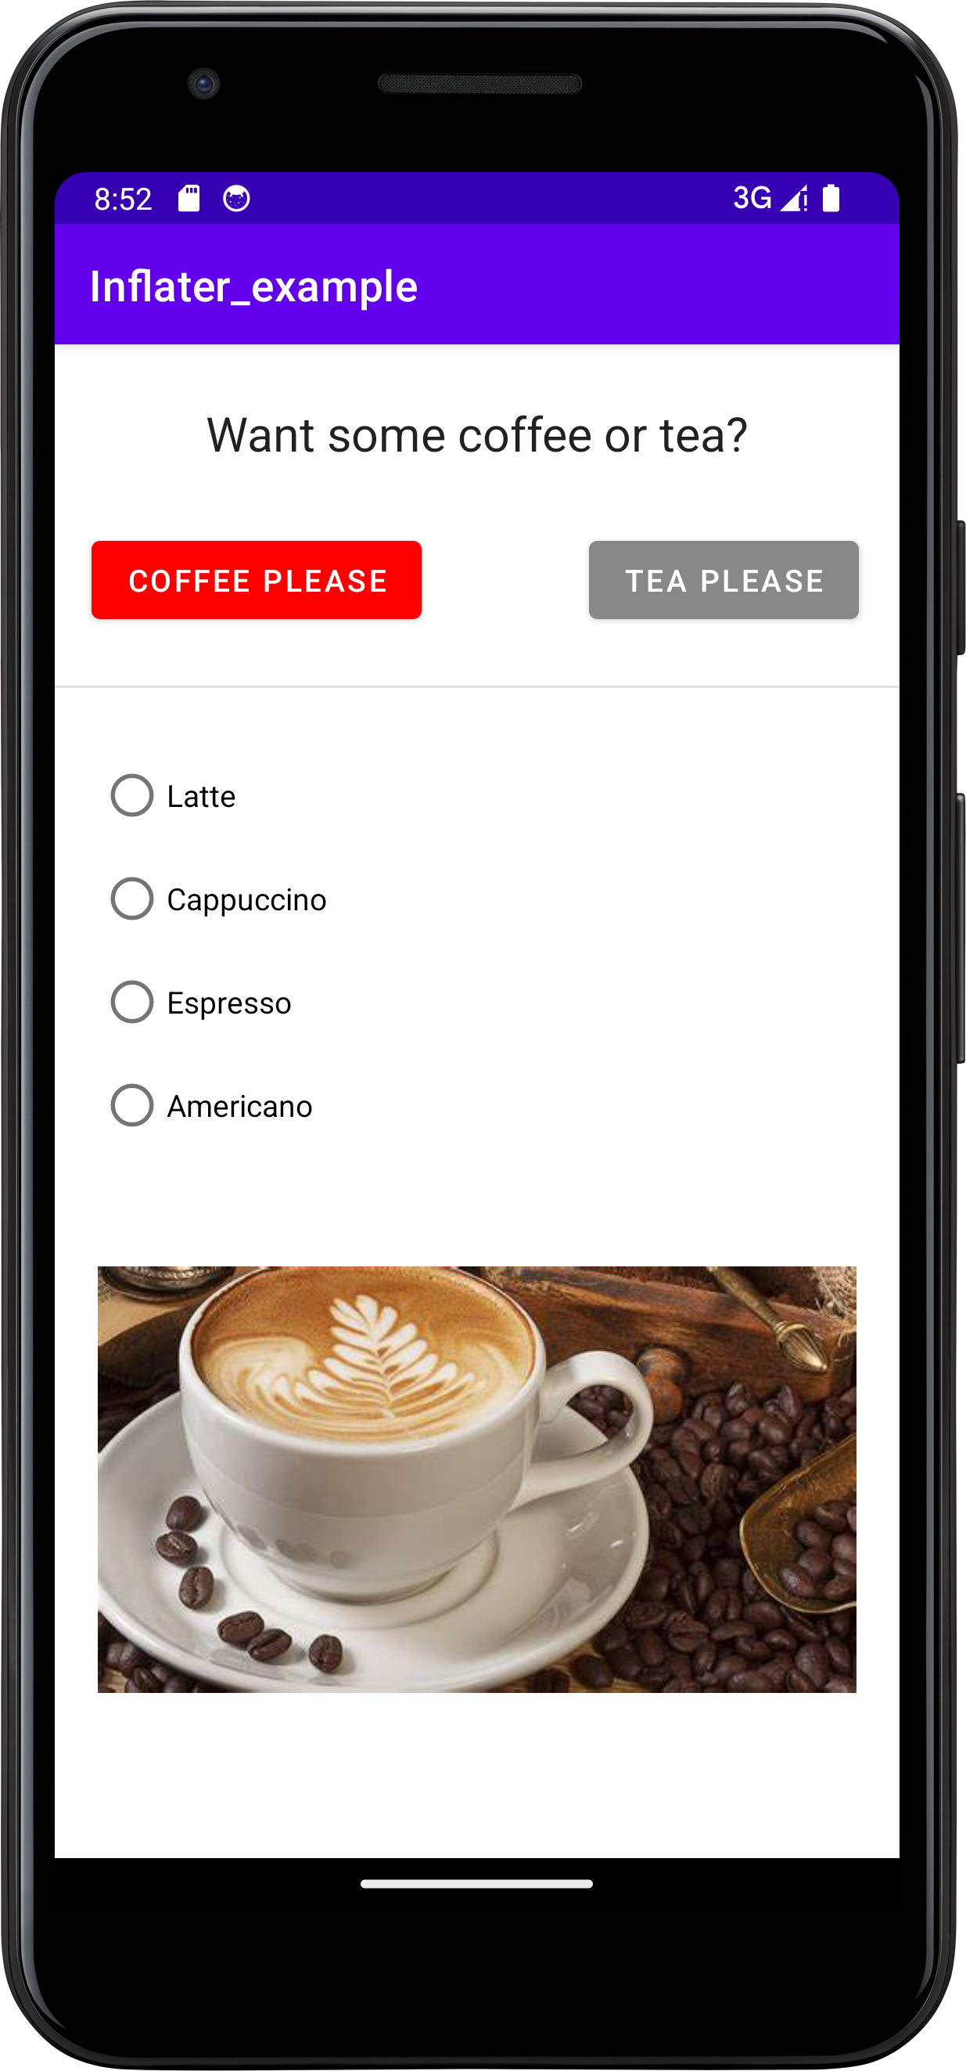
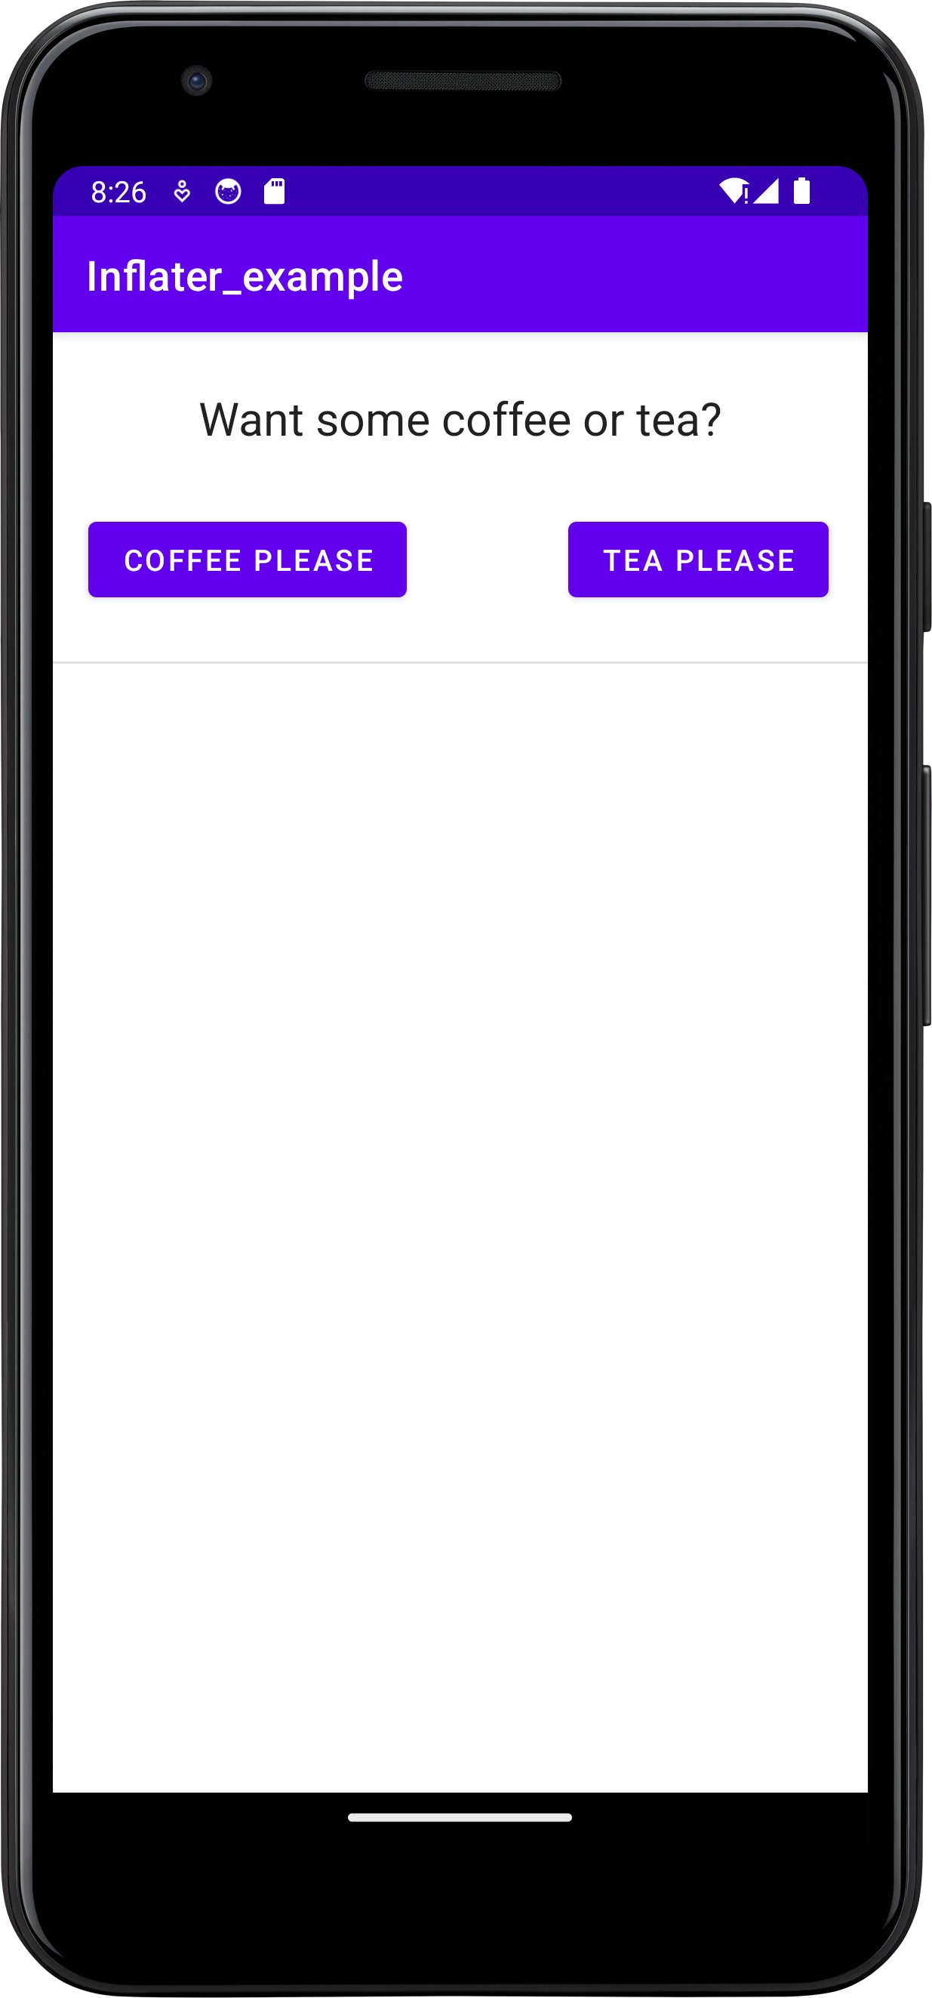
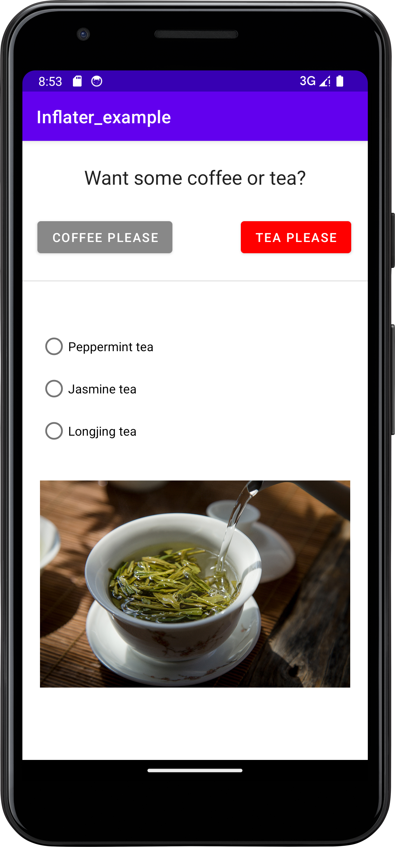
Loading Layout XML using Java Code
Using Java code to add Views one by one can be tedious.
You can load another layout XML using Java and add it to the current activity’s layout.
Example:

Slide 10
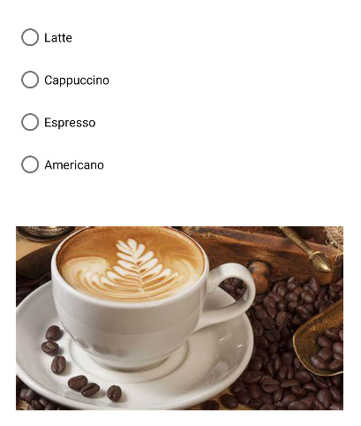
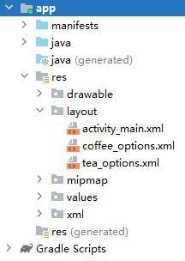
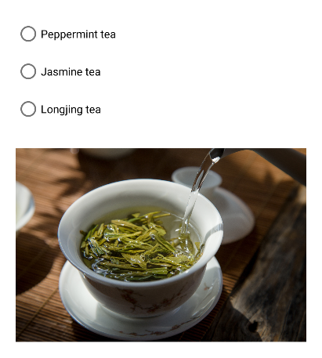
LayoutInflater
We have 3 layout XMLs.
“Coffee options” and “tea options” are loaded and shown when the corresponding button is clicked.
LayoutInflater allows you to load layout XMLs.
Notes:
https://www.runoob.com/w3cnote/android-tutorial-layoutinflater.html

Slide 11
Implementation
coffeePlsBtn.setOnClickListener((View view) -> { LayoutInflater inflater = LayoutInflater.from(this); ConstraintLayout mainLayout = findViewById(R.id.main_layout); LinearLayout coffee_list_layout = inflater.inflate( R.layout.coffee_options, null, false).findViewById(R.id.coffee_list_layout); ConstraintLayout.LayoutParams lp = new ConstraintLayout.LayoutParams( ViewGroup.LayoutParams.WRAP_CONTENT, ViewGroup.LayoutParams.WRAP_CONTENT); lp.leftToLeft = R.id.main_layout; lp.rightToRight = R.id.main_layout; lp.topToBottom = R.id.divider; lp.bottomToBottom = R.id.main_layout; mainLayout.addView(coffee_list_layout,lp); });
teaPlsBtn.setOnClickListener((View view) -> { LayoutInflater inflater = LayoutInflater.from(this); ConstraintLayout mainLayout = findViewById(R.id.main_layout); LinearLayout tea_list_layout = inflater.inflate( R.layout.tea_options, null, false).findViewById(R.id.tea_list_layout); ConstraintLayout.LayoutParams lp = new ConstraintLayout.LayoutParams( ViewGroup.LayoutParams.WRAP_CONTENT, ViewGroup.LayoutParams.WRAP_CONTENT); …… });

Slide 12
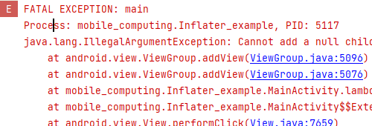
LayoutInflater VS findViewByID
You cannot directly use findViewByID() to get the external layout that hasn’t been loaded into the current activity.
It returns null.
Read more about LayoutInflater:
https://developer.android.google.cn/reference/android/view/LayoutInflater?hl=en
LinearLayout coffee_list_layout = findViewById(R.id.coffee_list_layout); ConstraintLayout.LayoutParams lp = new ConstraintLayout.LayoutParams( ViewGroup.LayoutParams.WRAP_CONTENT, ViewGroup.LayoutParams.WRAP_CONTENT); ...... mainLayout.addView(coffee_list_layout,lp);

Slide 13

Handling Events
Spinner example

Slide 14
Events
Android supports various user interaction events:
Click, long click (click and hold), drag, key press,
To receive a certain type of event, you need to implement its event listener and register it to the View.
Several listener interfaces are defined inside View:
View.OnClickListener
View.OnDragListener
View.OnLayoutChangeListener
Each listener contains only one callback method.
E.g. onClick() in View.OnClickListener.
Register the listener by calling View.setXXXListener(Listener)

Slide 15
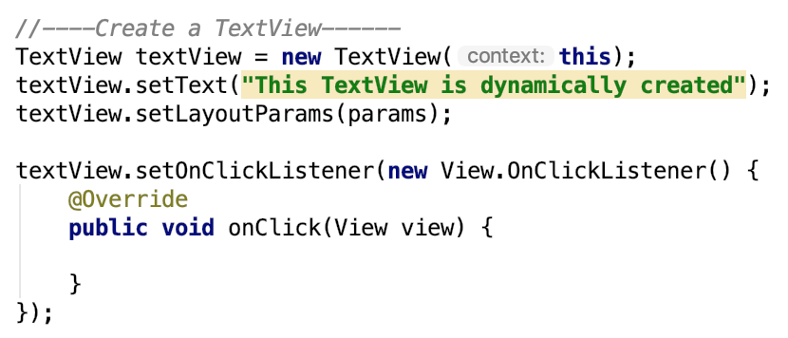
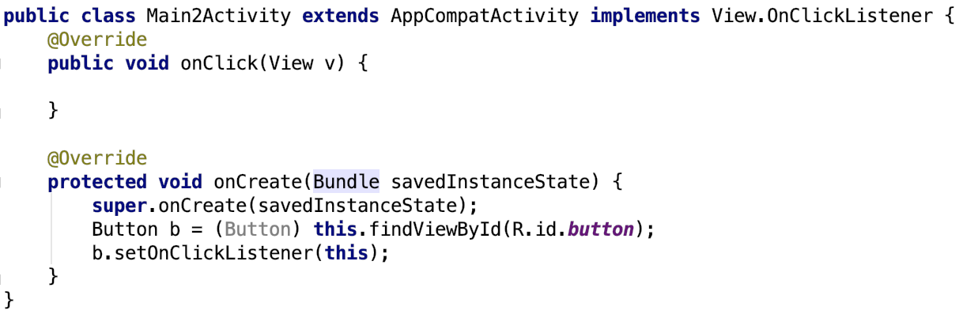
Event Listener Example 1 & 2

Slide 16
Event Listener Example 3: Spinner
Widgets like Spinner and ListView and GridView are capable of offering multiple choices to users.
Here, Spinner will be used as an example.
Assume we want to know the favourite activity of a user. You can create a spinner using:
UI Designer with predefined choices in “string.xml”.
Java code with dynamically created choices.

Slide 17
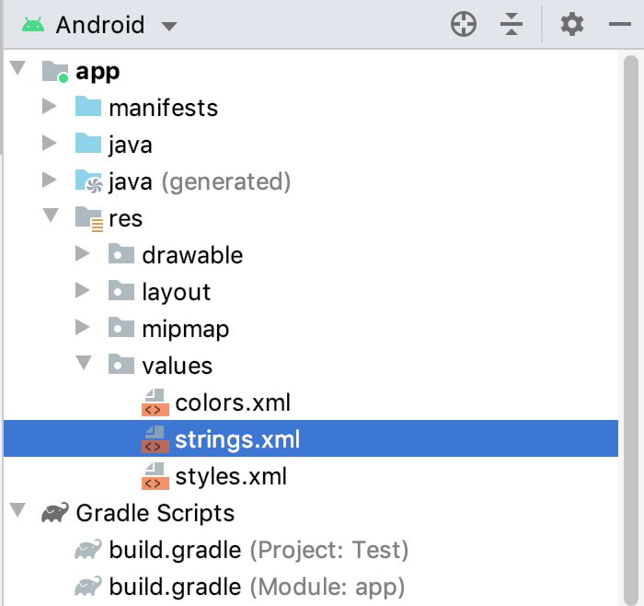
Spinner How-to
Step 1: create spinner prompt and options in strings.xml
<string name="prompt">Choose a hobby</string> <string-array name="hobbies"> <item>A</item> <item>B</item> <item>C</item> <item>D</item> </string-array>

Slide 18
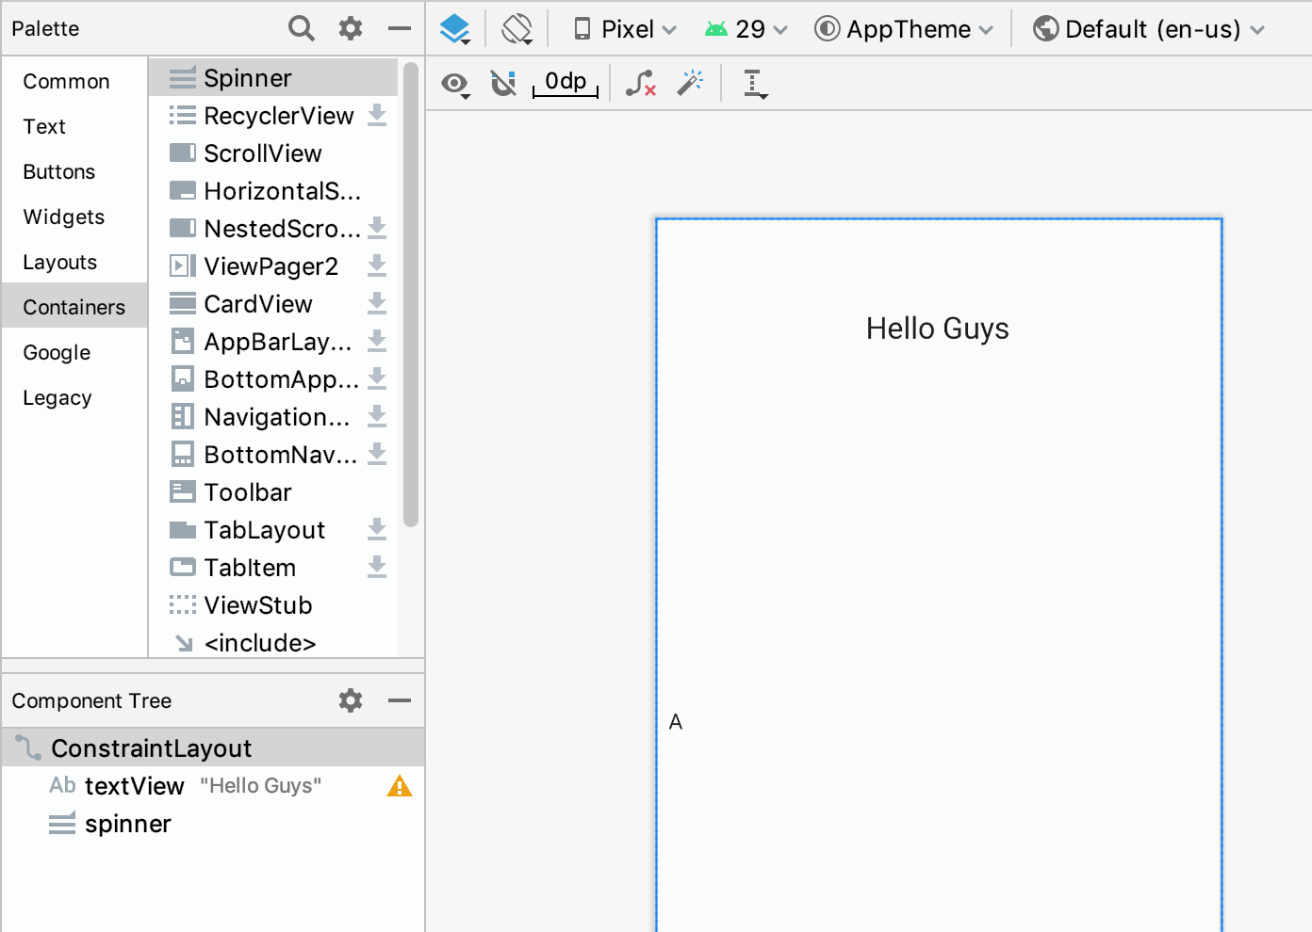
Spinner How-to
Step 2: Add the Spinner into the layout.
Open the layout, and add spinner into the layout.

Slide 19
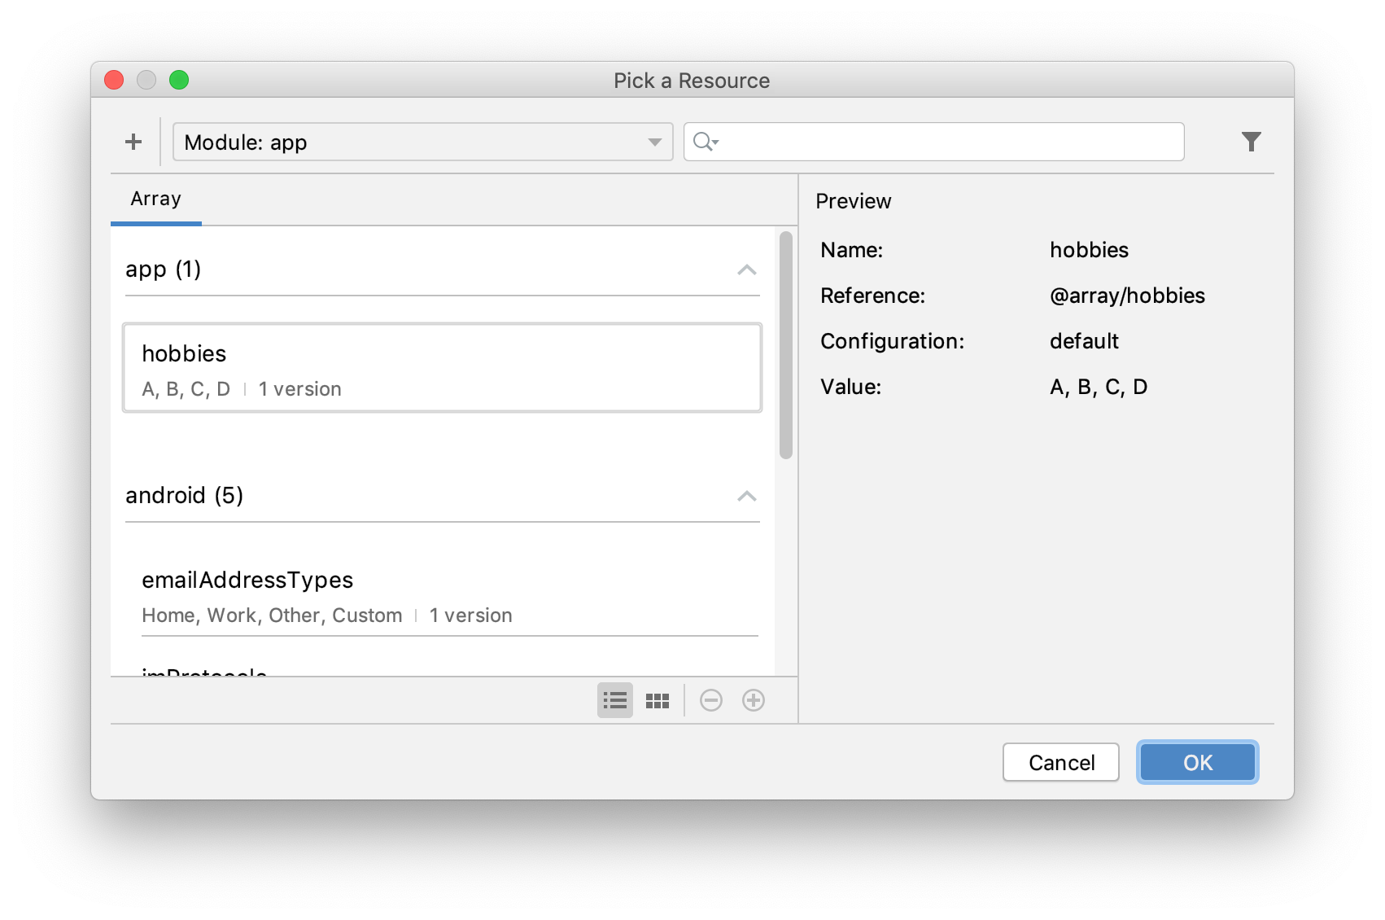
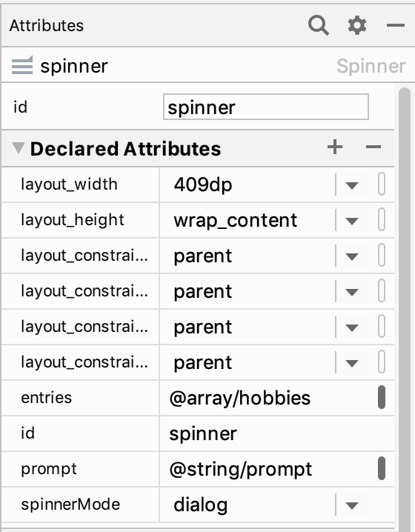
Spinner How-to
Step 3: Add the strings you defined in step 1.
In “declared attributes”, choose the prompt as well as the string array.
Click on this tiny button

Slide 20
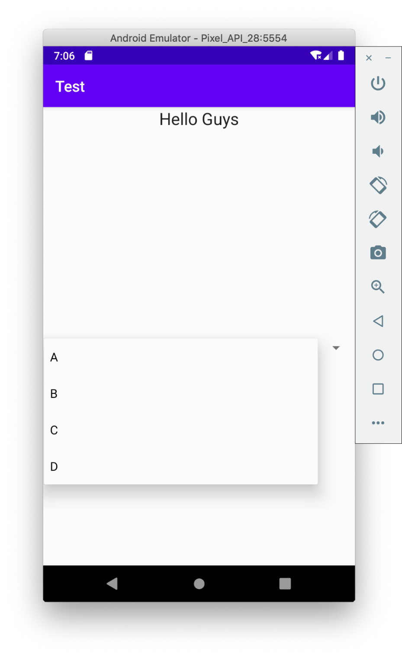
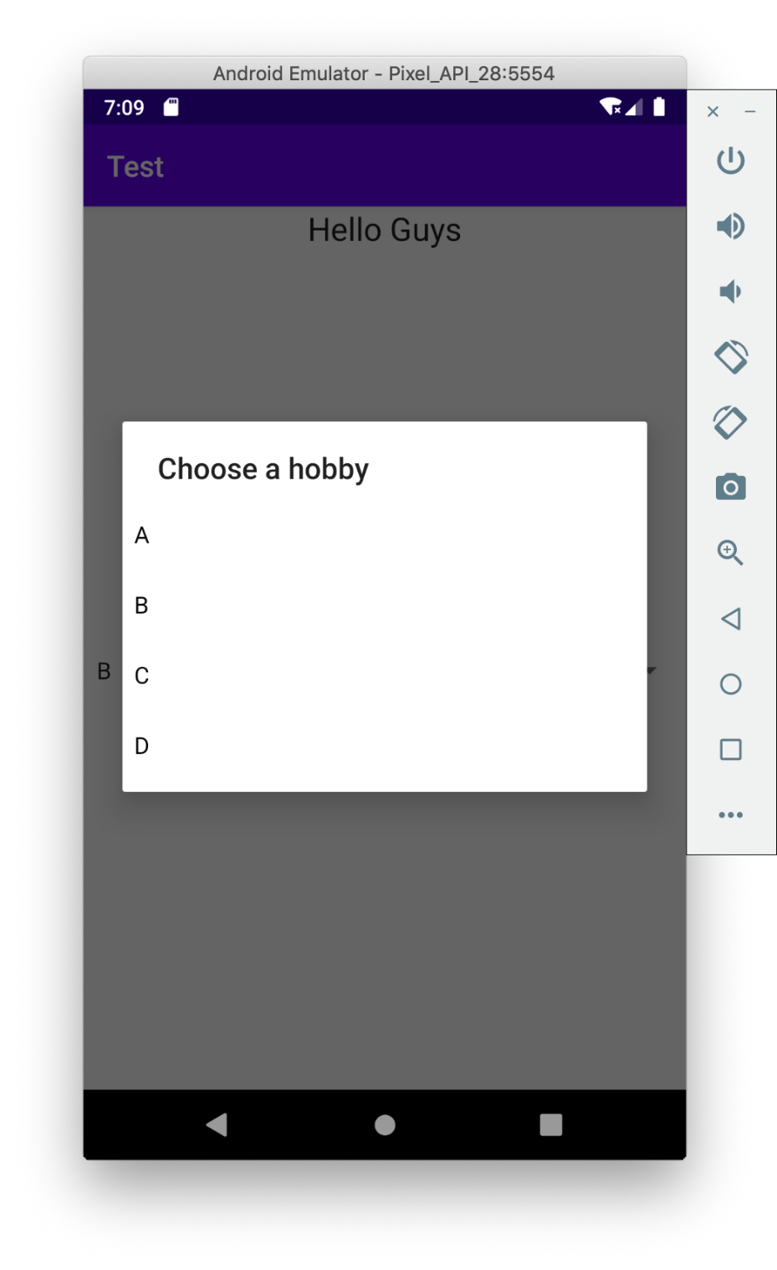
Spinner How-to
Step 4: Choose spinner mode: dialog or dropdown
Dropdown: No prompt
Dialog: shows the prompt

Slide 21
Spinner How-to
Step 5: Implement OnItemSelectedListener.
final Spinner s = findViewById(R.id.spinner); s.setOnItemSelectedListener(new Spinner.OnItemSelectedListener() { @Override public void onItemSelected(AdapterView<?> parent, View view, int position, long id) { …… } @Override public void onNothingSelected(AdapterView<?> parent) { } });
https://stackoverflow.com/questions/3009745/what-does-the-question-mark-in-java-generics-type-parameter-mean

Slide 22
onItemSelected()
Parameters:
parent – The AdapterView where the selection happened
view – The view within the AdapterView that was clicked
position – The position of the view in the adapter
id – The row id of the item that is selected
https://stackoverflow.com/questions/12965817/practical-difference-between-position-and-row-id-in-onlistitemclick
public void onItemSelected(AdapterView<?> parent, View view, int position, long id) { …… }

Slide 23
Manually Adding Items
The code below manually adds items to the spinner.
Spinner spinner2 = (Spinner) findViewById(R.id.spinner2); List<String> list = new ArrayList<String>(); list.add("Sing"); list.add("Dance"); list.add("Rap"); list.add("Basketball"); ArrayAdapter<String> dataAdapter = new ArrayAdapter<String> (this, android.R.layout.simple_spinner_item, list); spinner2.setAdapter(dataAdapter);

Slide 24
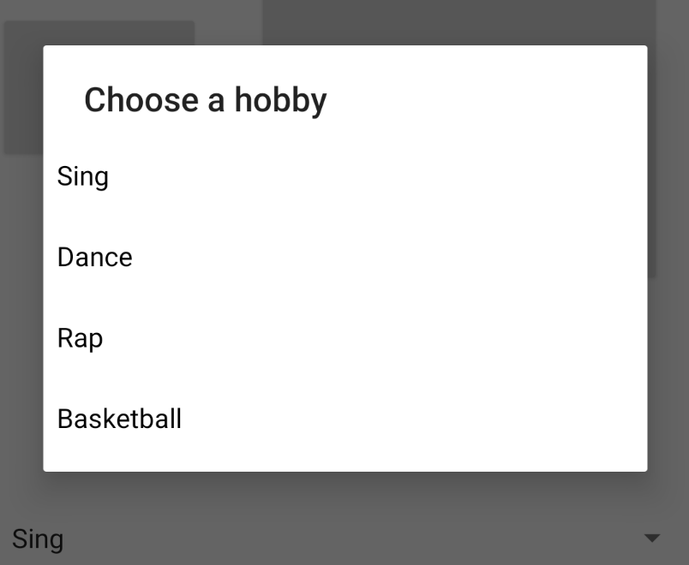
Extended Reading
An AdapterView is a view whose children are determined by an Adapter.

Slide 25
Adapter & Adapter View
The ArrayAdapter we saw is a BaseAdapter backed by an array of arbitrary objects.
It’s a subclass of BaseAdapter
A BaseAdapter is an implementation of Adapter interface that can support ListView and Spinner.
An Adapter object acts as a bridge between an AdapterView and the underlying data for that view.
An AdapterView is a View whose children are determined by an Adapter.
Spinner, ListView, GridView are different AdapterViews.

Slide 26
Main Thread (UI Thread)
Changing UI concurrently:
runOnUiThread, AsyncTask, View.post()

Slide 27
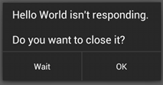
Main Thread
Android Uses a single thread to draw UI, listen for events and invoke activity life cycle functions of an app.
If this thread gets blocked for too long, Android Not Responsive (ANR) error will be thrown to the user.
Block: Thread.sleep() or similar situations
Bad app user experience = a good reason to uninstall.
To prevent this annoying error, you need to create new threads for long running background work.

Slide 28
Modifying UI from Other Threads
Now consider this situation:
User clicks a play button.
The app plays a short piece of music in the background.
Then the button’s shape need to change to “stopped”.
What is your design?
Create a thread to play the music.
Wait for the “play” thread? That will block the UI thread.
Let the “play” thread finish and then let it change the button?

Slide 29
Modifying UI from Other Threads
Unfortunately, UI (widgets and layouts) can only be changed by the main thread.
You can start an activity using non-UI threads though.
Attempting to use non-UI thread to change UI, CalledFromWrongThreadException might be thrown.
Using only the UI thread to manage UI can make your app much easier to debug and run more robust.
There are a few methods to enable UI and non-UI threads to communicate.

Slide 30
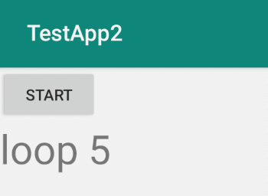
Modifying UI from Other Threads
We are introducing 3 approaches:
Activity.runOnUiThread(Runnable)
View.post(Runnable)
AsyncTask
Examples scenario: Click start button, then for every 1 second, the content of a TextView is changed. Last 5 sec.
Loop 1 -> 2 -> 3 -> 4 ->

Slide 31
Firstly, the Incorrect Solution
Button startButton = findViewById(R.id.startButton); startButton.setOnClickListener(
new View.OnClickListener() { @Override public void onClick(View v) { for (int i = 1; i <= 5; i++) { try { Thread.sleep(1000); } catch (InterruptedException e) { e.printStackTrace(); } TextView label = findViewById(R.id.messageLabel); label.setText("loop " + i); } } });

Slide 32
@Override public void onClick(View v) { new Thread(new Runnable() { @Override public void run() { for(labelVal = 1; labelVal <= 5; labelVal++) { try { Thread.sleep(1000); } catch (InterruptedException e) { e.printStackTrace(); } runOnUiThread(new Runnable() { @Override public void run() { TextView label =
findViewById(R.id.messageLabel); label.setText("loop " + labelVal); } }); } } }).start(); }
From the UI thread:
Start thread #1
Sleep in Thread #1
Set label in the UI thread
Activity.runOnUiThread()

Slide 33
public void onClick(View v) { new Thread(new Runnable() { @Override public void run() { final TextView label = findViewById(R.id.messageLabel); for(labelVal = 0; labelVal < 5; labelVal++) { try { Thread.sleep(1000); } catch (InterruptedException e) { e.printStackTrace(); } label.post(new Runnable() { @Override public void run() { label.setText("loop " + labelVal); } }); } } }).start(); }
UI Thread
View.post(Runnable)

Slide 34
Method 3: AsyncTask
AsyncTask is a generic class that has four key functions.
Three functions that run on the UI thread:
onPreExecute()
onPostExecute()
onProgressUpdate()
And a function that is carried out in another tread:
doInBackground()

Slide 35
AsyncTask: the Work Flow
Create an object of AsyncTask, and call execute()
onPreExecute() will be run on the UI thread first.
doInBackground(Params... params) will then be run on a separate thread.
You can call onProgressUpdate(Progress... values) during this period, all logic will be run on the UI thread.
onPostExecute(Result result) will be done on the UI thread.
AsyncTask<Params, Progress, Result>

Slide 36
Solution Using AsyncTask
To implement our task using AsyncTask:
Create a subclass of AsyncTask, preferably inside our Activity class so that we can access important functions like findViewByID().
Override doInBackground() and onPostExecute().
Create an object of our AsyncTask and use it inside onClick() function of the “start” button

Slide 37
public class MainActivity extends AppCompatActivity {
class SetLabelTask extends
AsyncTask<Integer, Void, Integer> { @Override protected Integer doInBackground(Integer... integers) { try { Thread.sleep(1000); } catch (InterruptedException e) { e.printStackTrace(); } return integers[0]; } @Override protected void onPostExecute(Integer i) { final TextView label =
findViewById(R.id.messageLabel); label.setText("Loop " + i); } }
……
The “loop i” integer
AsyncTask: Create Class

Slide 38
AsyncTask<Params, Progress, Result>
protected Result doInBackground(Params... params)
{ … return result; }
Non-UI Thread
protected void onPostExecute(Result i) { … }
UI Thread
AsyncTask: Create Class

Slide 39
public void onClick(View v) { for (int i = 0; i < 5; i++) { new SetLabelTask().execute(i + 1); } }
doInBackground(Params... params)
AsyncTask<Params, Progress, Result>
You may cancel an AsyncTask at any time, in any thread, using AsyncTask.cancel() function
AsyncTask: onClick()

Slide 40
Notifications
Toasts, Notifications

Slide 41
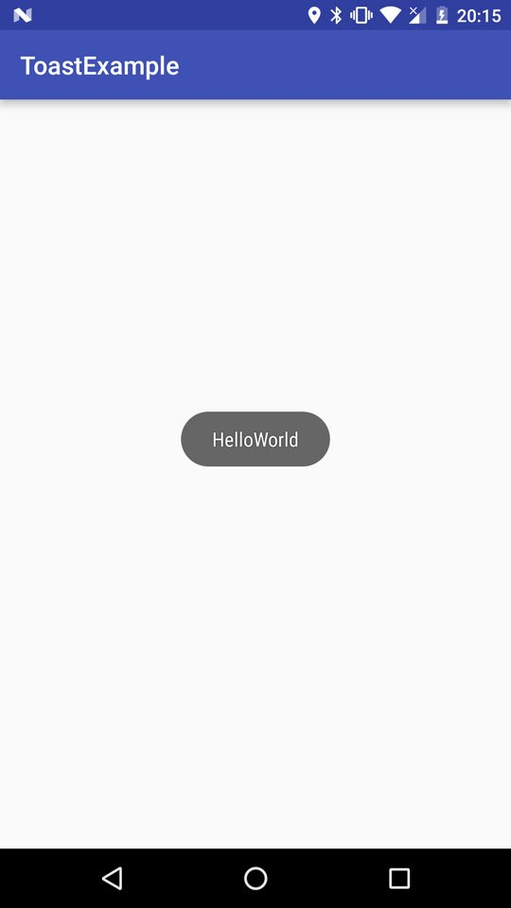
Toast
Toast is a lightweight notification that
Shows a simple message in the centre of the screen for a brief while.
Does not interrupt the running of the current app.
Users cannot interact with a toast.

Slide 42
Showing a Toast
Create an Toast object using Toast.makeText(context, message, duration).
Duration: Toast.LENGTH_LONG or Toast.LENGTH_SHORT
Optionally, adjust the toast position with setGravity()
Then, Call show() method.
public class MainActivity extends AppCompatActivity { @Override protected void onCreate(Bundle savedInstanceState) { super.onCreate(savedInstanceState); Toast t = Toast.makeText(MainActivity.this, "Toasted", Toast.LENGTH_SHORT); t.setGravity(Gravity.FILL_HORIZONTAL,0,0); t.show(); } }

Slide 43
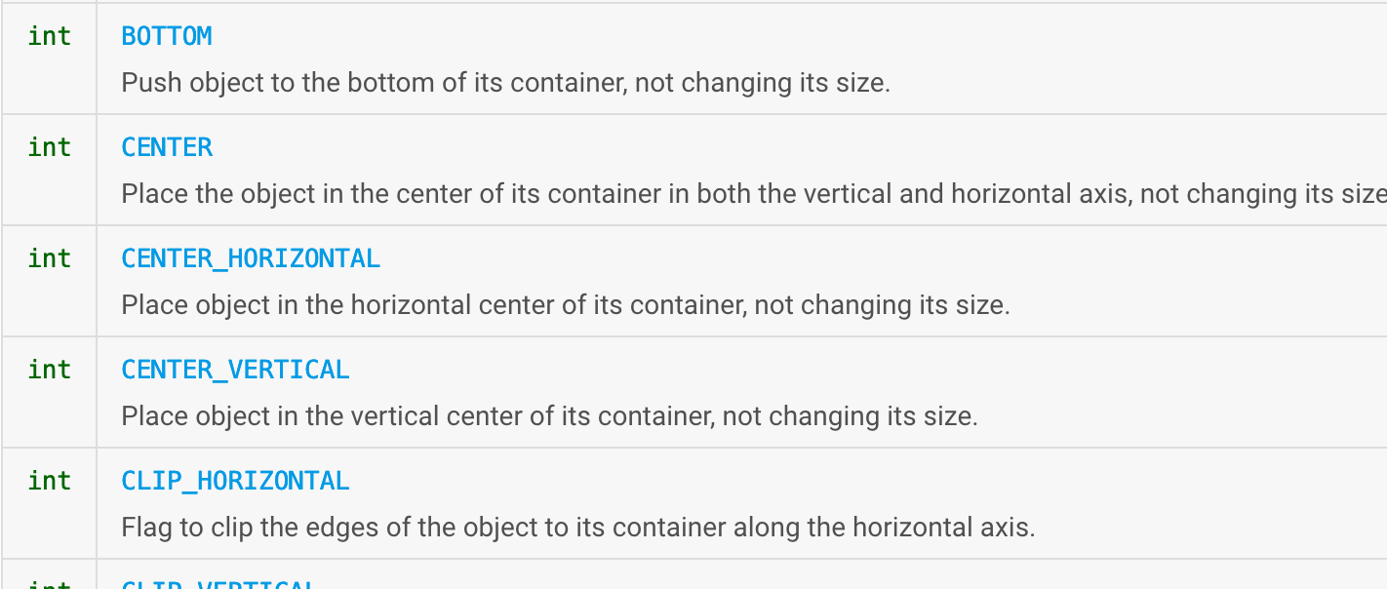
Gravity settings
They are constants defined inside the Android.view.Gravity class.

Slide 44
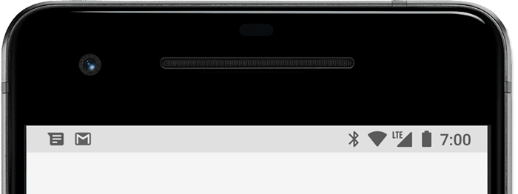
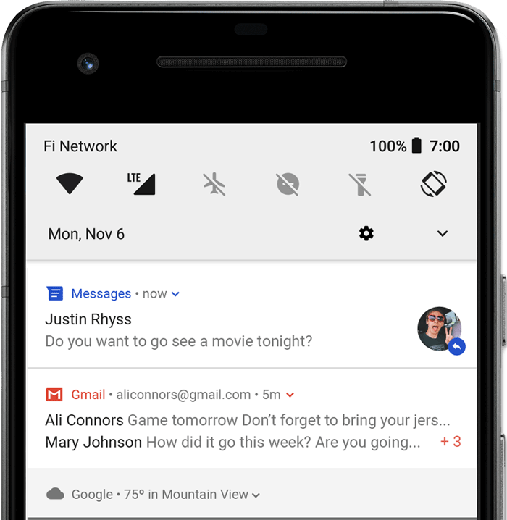
Notification
Notifications are shown:
In the status bar on the top of the screen.
In the notification drawer.
A notification can be configured to allow users to tap it to go to a specified activity.

Slide 45
Creating a Notification
First create a notification channel if the target Android version is 8 (API level 26) or above.
Create and configure the notification content and style.
Optionally, set the notification’s tap action.
Notes:
Why notification channel is needed above API 26? Any design reasons?

Slide 46
What is a Notification Channel?
Considering a message app that can send and receive messages from friends.
When a message fails to send, the app makes a sound and shows a notification.
When a message arrives, the app makes a different sound and shows a notification.
Notification channel allows an app to have different styles of notifications, for different situations.

Slide 47
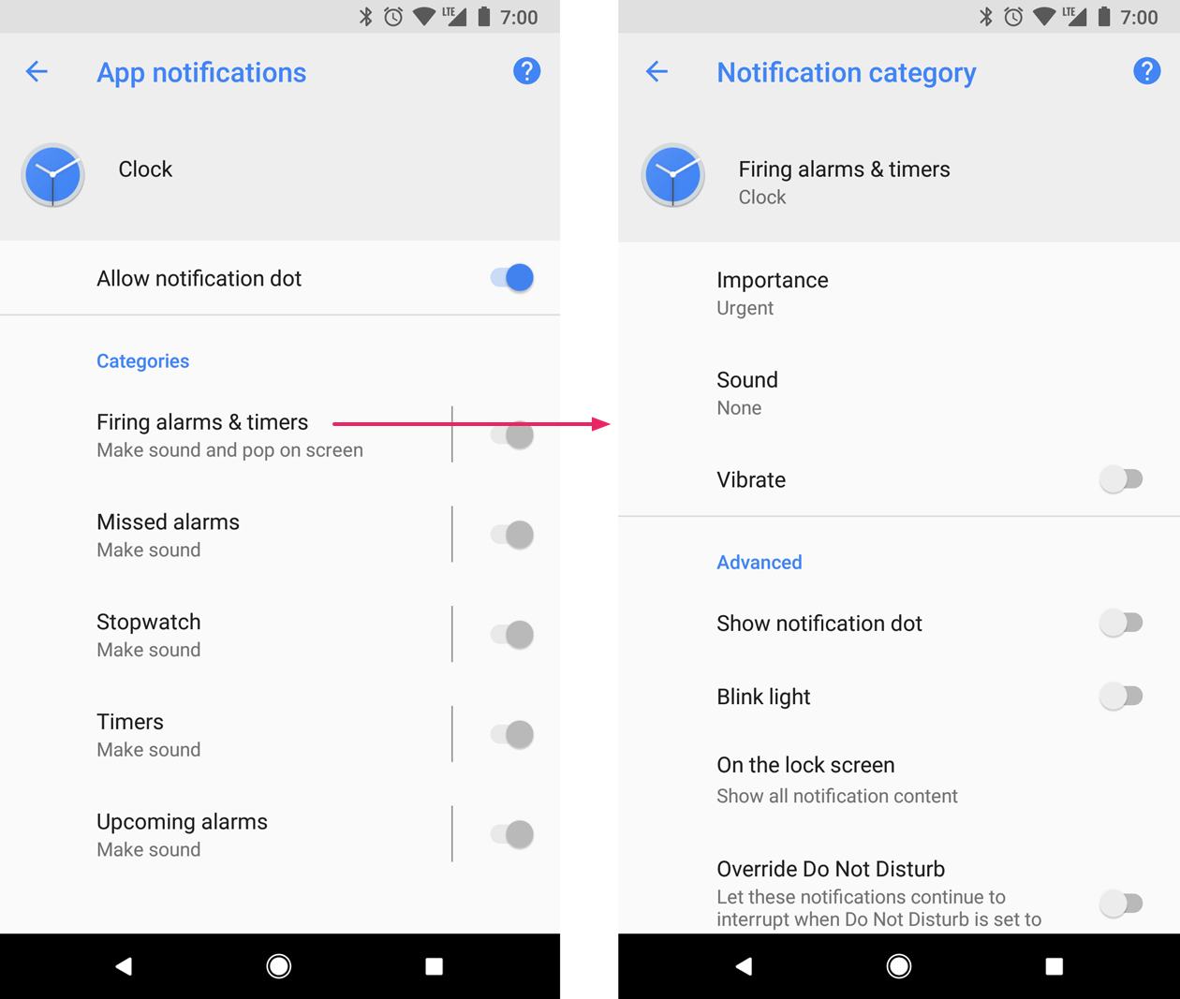

Slide 48
Why Notification Channel?
Why we need to create channels first? Why not letting the app to decide the settings of a notification every time it is fired?
All channels are registered in the system. Users can override the channel behaviours later.
Apps can no longer control the behaviours of a channel once created.
Overall answer: prevents badly-designed apps from annoying users,

Slide 49
Call this function early in your app. Such as in onCreate()
This is “oh”, not zero. It means Android Oreo, Version 8, API level 26
private void createNotificationChannel() { if (Build.VERSION.SDK_INT >= Build.VERSION_CODES.O) { NotificationChannel channel1 = new NotificationChannel(CHANNEL_IDS[0], "Channel 1 (channel name)", NotificationManager.IMPORTANCE_HIGH);
channel1.setDescription("description 1");
// Register the channel, you can't change the importance // or other notification behaviors after this NotificationManager notificationManager =
getSystemService(NotificationManager.class); notificationManager.createNotificationChannel(channel1); } }
This is a String that needs to be defined by yourself. It is needed later.
https://developer.android.google.cn/training/notify-user/channels.html#importance
You CANNOT create a notification channel with the same ID again. Newer requests will just be ignored.
Creating Channels

Slide 50
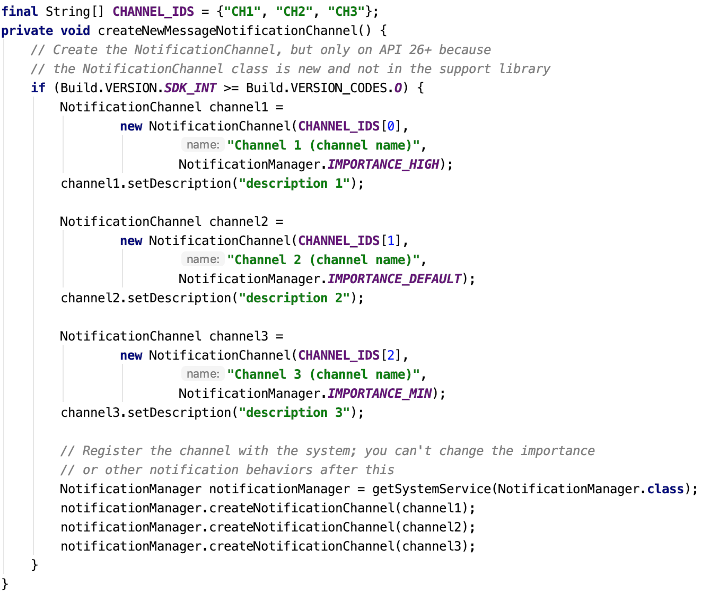
All channels

Slide 51
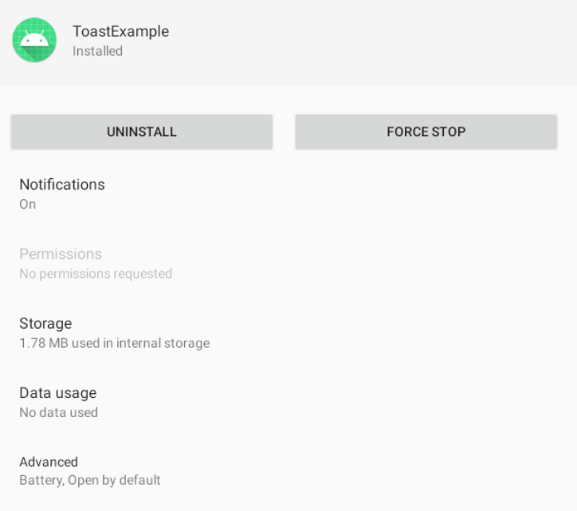
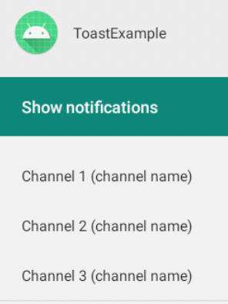
Channels in the System Settings
Once this function is run, three channels will be created for this app.
Users can change the behaviours of each channel.

Slide 52
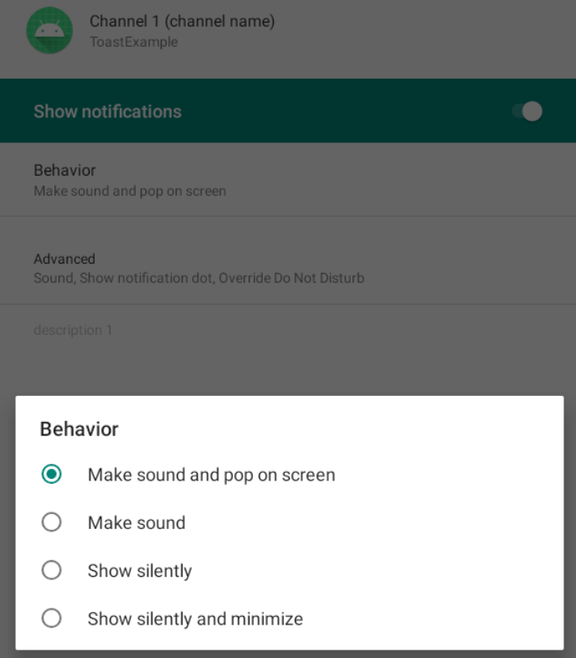
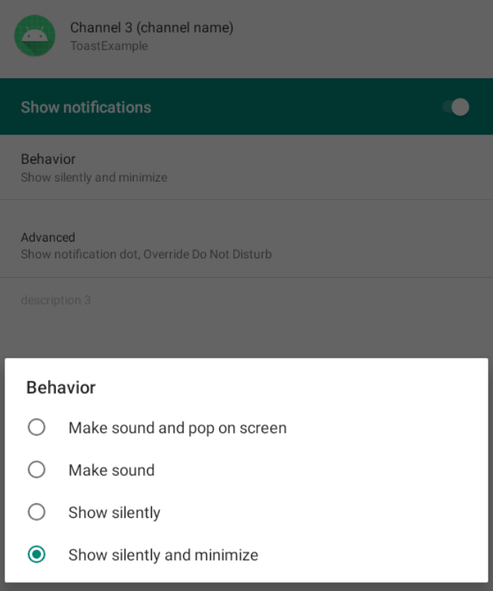
Channel Importance Level
NotificationManager.IMPORTANCE_HIGH
NotificationManager.IMPORTANCE_MIN

Slide 53
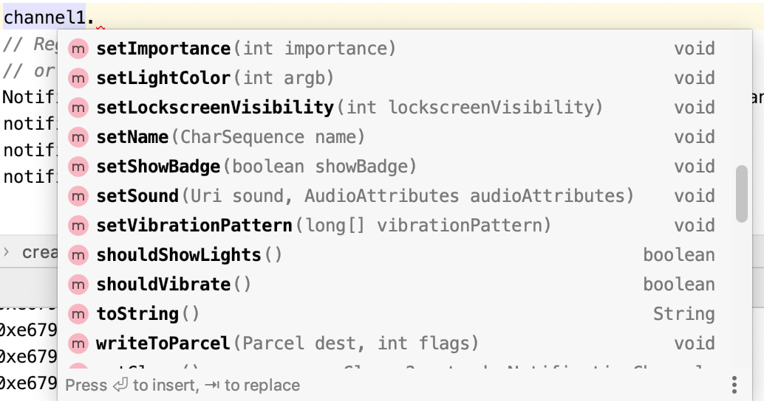
Other Channel Settings
There are many settings available. Please check the functions of the NotificationChannel class.

Slide 54
Preparing Notification Content
Notification is shown when this button is clicked
createNotificationChannel(); Button notif = findViewById(R.id.notif_btn); notif.setOnClickListener(new Button.OnClickListener() { @Override public void onClick(View v) { Notification.Builder builder =
new Notification.Builder(MainActivity.this, CHANNEL_IDS[0]);
builder.setSmallIcon(R.mipmap.ic_launcher); builder.setContentTitle("Notification title"); builder.setContentText("My app's notification content");
......
Context
This function is for API 26 and higher. You can use
new Notification.Builder(MainActivity.this);
for lower versions.
That’s the channel we created

Slide 55
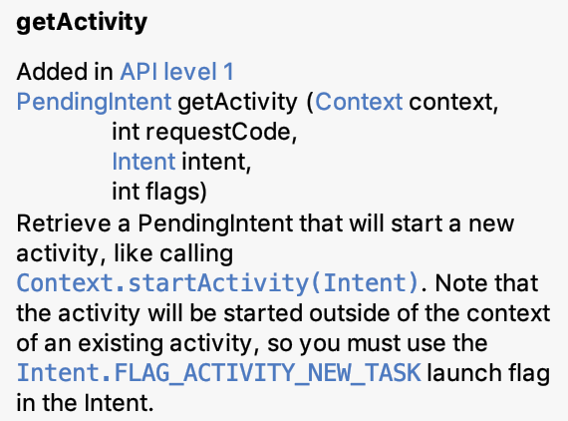
Setting Notification’s Tap Action
You can ask the notification to redirect the user to a certain activity:
Intent redir = new Intent(MainActivity.this, Activiteee.class); PendingIntent pendingIntent = PendingIntent.getActivity(MainActivity.this, 0, redir, 0);
builder.setContentIntent(pendingIntent);

Slide 56
PendingIntent
“…can be handed to other applications so that they can perform the action you described on your behalf at a later time.”
PendingIntent still exists even if the app that created it is ended.
“By giving a PendingIntent to another application, you are granting it the right to perform the operation you have specified as if the other application was yourself (with the same permissions and identity)”

Slide 57
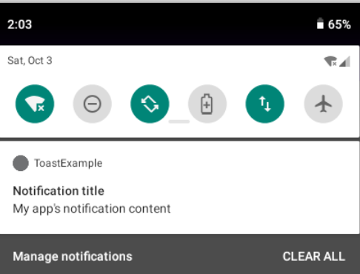
Showing/Cancelling a Notification
Notification notification = builder.build(); NotificationManager manager =
(NotificationManager) getSystemService(NOTIFICATION_SERVICE); manager.notify(1, notification);
// after a long time manager.cancel(1);
Show notification, using id “1”.
Cancel notification, using id “1”. IDs must match
Notes:
This will display the same notification twice :)
manager.notify(1, notification);
manager.notify(2, notification);

Slide 58
More Details about Notifications
https://developer.android.google.cn/guide/topics/ui/notifiers/notifications?hl=en

Slide 59
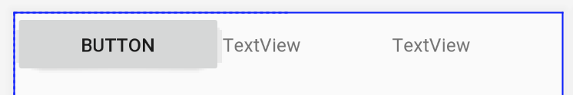
Lab Tasks
Task 3: Create a simple layout like below.
When the app starts, the two TextViews’ text colour alternates between blue and red at the frequency of 1 change per second.
By clicking the button, the colour will stay unchanged for 5 seconds and then start again.
Hello world
Hello world
Hello world
Hello world
Hello world

